Slide 1
Course
AWS Cloud Practitioner
MaxCloud

Slide 2
03
Class
Amazon EC2 Auto Scaling
Amazon EC2
Amazon EBS

Slide 3
Elastic Load Balancing
Elastic Load Balancing supports the following load balancers:
Classic Load Balancers
Application Load Balancers
Network Load Balancers
Gateway Load Balancers

Slide 4
Classic Load Balancer
A load balancer distributes incoming application traffic across multiple EC2 instances in multiple Availability Zones. This increases the fault tolerance of your applications. Elastic Load Balancing detects unhealthy instances and routes traffic only to healthy instances.
Your load balancer serves as a single point of contact for clients. This increases the availability of your application. You can add and remove instances from your load balancer as your needs change, without disrupting the overall flow of requests to your application.

Slide 5
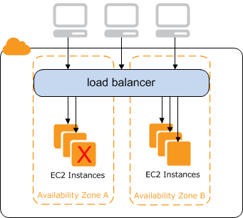
CLB Diagram

Slide 6
Application Load Balancers
Elastic Load Balancing automatically distributes your incoming traffic across multiple targets, such as EC2 instances, containers, and IP addresses, in one or more Availability Zones.
It monitors the health of its registered targets, and routes traffic only to the healthy targets.
Elastic Load Balancing scales your load balancer as your incoming traffic changes over time. It can automatically scale to the vast majority of workloads.
An Application Load Balancer functions at the application layer, the seventh layer of the Open Systems Interconnection (OSI) model.
Application Load Balancers support the following protocols on front-end connections: HTTP/0.9, HTTP/1.0, HTTP/1.1, and HTTP/2

Slide 7
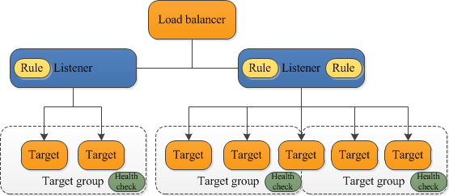
ALB Diagram

Slide 8
Network Load Balancers
Elastic Load Balancing automatically distributes your incoming traffic across multiple targets, such as EC2 instances, containers, and IP addresses, in one or more Availability Zones.
It monitors the health of its registered targets, and routes traffic only to the healthy targets.
Elastic Load Balancing scales your load balancer as your incoming traffic changes over time. It can automatically scale to the vast majority of workloads.
A Network Load Balancer functions at the fourth layer of the Open Systems Interconnection (OSI) model.
Network Load Balancer target groups support the TCP, UDP, TCP_UDP, and TLS protocols

Slide 9
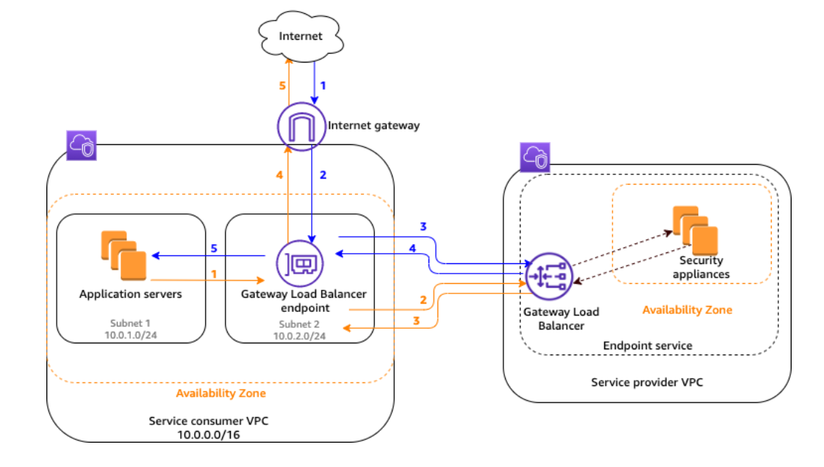
Gateway Load Balancers

Slide 10
Muchas Gracias

